Slide 1
Positive Behaviour Supports
The 3 R’s: review, roles and responsibilities

Slide 2

The 3 R’s
Review
Roles and Responsibilities
EA Allocation
Planning Tool

Slide 3

BCTF/CUPE Joint Paper

Slide 4

EA Allocation Planning Tool

Slide 5
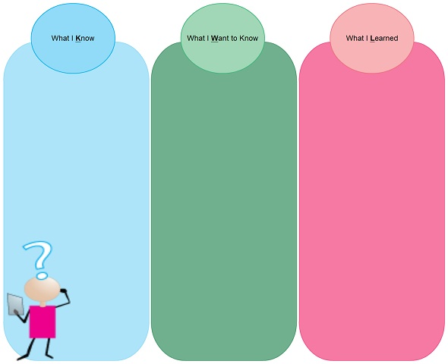
At this time what do you know?

Slide 6
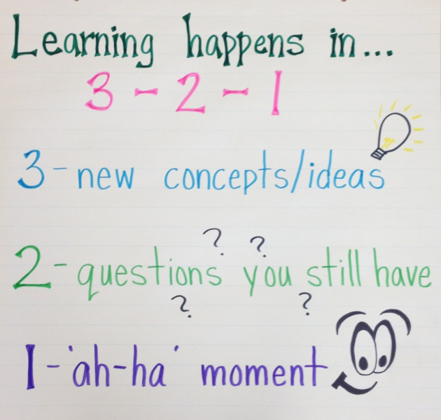
Exit card

